Slide 1
General Concepts & Functions

Slide 2
Echo Statement
You can also give multiple arguments to the unparenthesized version of echo, separated by commas, as in:
echo “This will print in the “,“user’s browser window.”;
The parenthesized version, however, will not accept multiple arguments:
echo (“This will produce a “, “PARSE ERROR!”);

Slide 3
Use of <br /> and \n
Use of \n- newline
echo “line 1 \n”;
echo “line 2”; Will produce line 1 line 2
Used of <br />
echo “line 1<br />”;
echo “line 2”; Will produce line 1
line 2

Slide 4
Constants
Always stay the same once defined
Constants are defined with the define() function.
Example: define(“VARIABLE1”, “value”);
Constant names follow the same rules as variable names
Constants are typically named all in UPPERCASE but do not have to be.

Slide 5
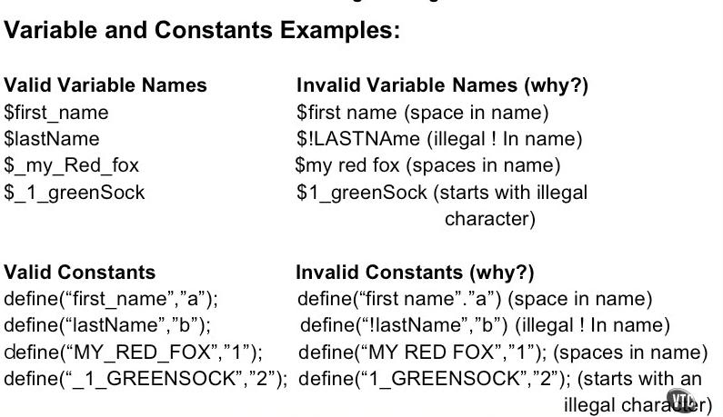
Variables and Constants Ex:

Slide 6
Constants
One important difference between constants and variables is that when you refer to a constant, it does not have a dollar sign in front of it.
If you want to use the value of a constant, use its name only.
define(‘OILPRICE’,10);
echo OILPRICE;

Slide 7
Sample Program for Constant Declaration
<?php
define(“USER”,”Grace”);
echo “Welcome ” . USER;
?>
Output:
Welcome Grace

Slide 8
Data Conversion
In PHP, the type of the variable depends on the value assigned to it.
<?php $foo = “0”; //$foo is string $foo += 2; // $foo is an integer $foo = $foo + 1.3; // $foo is now a float $foo = 5 + “10 Piggies”; //$foo is an integer (15) ?>

Slide 9
Typecasting
There are circumstances in which you will want to control how and when individual variables are converted from one type to another.
There are two ways to cast a variable in PHP as a specific type. The first is called typecasting or just casting.
Typecasting forces a variable to be evaluated as another type.
The name of the desired type is written in parentheses before the variable that is to be cast.

Slide 10
Typecasting-Integers
You can typecast any variable to an integer using the (int) operator.
Floats are truncated so that only their integer portion is maintained.
echo (int) 99.99; //99
Booleans are cast to either one or zero
echo (int) TRUE //1
echo (int) FALSE // 0
Strings are converted to their integer equivalent
echo (int) “test 123” ; //0
echo (int) “123”;
echo (int) “123test”;
NULL always evaluates to zero.

Slide 11
Typecasting Booleans
Data is cast to Boolean using the (bool) operator
echo (bool) 1; //true
Numeric values are always TRUE unless they evaluate to zero
Strings are always TRUE unless they are empty
echo (bool) “ABC” //true
Null always evaluates to FALSE.

Slide 12
Typecasting- Strings
Data is typecast to a string using the (string) operator:
echo (string) 123; // “123”
Numeric values are converted to their decimal string equivalent:
echo (string) 123.1 // “123.1”;
Booleans evaluate to either “1” (TRUE) or an empty string (FALSE)
NULL values evaluates to an empty string.

Slide 13
Typecasting
The casts allowed are:
(int), (integer) - cast to integer
(bool), (boolean) - cast to boolean
(float), (double), (real) - cast to float
(string) - cast to string
(array) - cast to array
(object) - cast to object
(unset) - cast to NULL (PHP 5)
(binary) casting (since PHP 5”

Slide 14
gettype()
Gets the type of a variable
Returns “boolean”, “integer”, “double”, “string”, “array”, “object”, “resource”, “NULL”.
<?php $foo = 2.5; //$foo is a float $bar =(int) $foo+1; // $bar is an int (3) //outputs: $bar=3, type:integer echo ‘$bar = ‘.$bar. ‘, type: ‘ .gettype($bar); //outputs: $foo= 2.5, type: double echo ‘$foo = ‘ . $foo . ‘, type: ‘.gettype($foo);

Slide 15
settype()
This is the second way to cast a variable in PHP as a specific type
Sets the type of a variable
“boolean”, “integer”, “double”, “string”, “array”, “object”, “resource”, “NULL”
<?php $foo= 2.0; //$foo is a float settype($foo, “integer”); //$foo is an int $bar =$foo + 1; // $bar is an int (3) //outputs: $bar =3, type: integer echo ‘$bar = ‘ .$bar . “,type: “ . gettype($bar); //Outputs: $foo=2, type: integer echo ‘$foo = ‘ . $foo . “,type: “ . gettype($foo); ?>

Slide 16
Differences between casting and settype()
The difference between using settype() to change the type of an existing variable and changing type by casting is the fact that casting produces a copy, leaving the original variable untouched.
$newvar = (integer) $originalvar;
Here $originalvar variable is still available, and is in its original type; $newvar is a completely new variable.

Slide 17
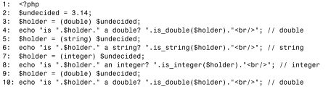


Differences between casting and settype()

Slide 18
Notes:
Use the is_* family to test type as the gettype() can be slow and is likely to be deprecated in future releases.
The ability to change the contents of a variable from 1 type to another either by using settype() or casting is useful.
As PHP automatically casts your variables for you when the context of the script requires it is not often you will need to do so yourself, however this cast is temporary and you might want to make a variable persistently hold a particular data type.
Example: Numbers you will enter through a textbox are made available to your script as strings so you might want to clean up the user input before you use it

Slide 19
Why do we need to cast?
$test = “30cm”; //value user enters
$newtest = (integer) $test;
echo “your imaginary box has a width of $newtest centimetres”;
This outputs :
your imaginary box has a width of 30 centimetres
Had the user input not been cast and he value of $test been used in place of $newtest, the output would be:
your imaginary box has a width of 30cm centimetres

Slide 20
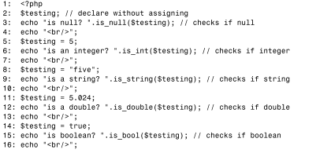
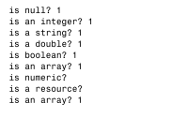
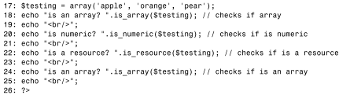
IS_* Family

